Slide 1


Stock Market Prediction
USING
MACHINE LEARNING
Akshay R 1ST14CS010
Aravind B 1ST14CS023
Arun Kumar 1ST14CS025
Ashok S 1ST14CS027
Under the guidance of
Dr. T John Peter
H.O.D, Dept. of CSE
Sambhram Institute of Technology
Department of Computer Science & Engineering

Slide 2

Stock Market Prediction
Abstract
Performance
Introduction
Future Enhancement
Agenda
Existing Methods
Conclusion
Proposed System
System Design
Implementation
Results & Discussions

Slide 3

Abstract
Stock Market Prediction
Time series forecasting has been widely used to determine the future prices of stock, and the analysis and modelling of finance time series importantly guide investors’ decisions and trades
This work proposes an intelligent time series prediction system that uses sliding-window optimization for the purpose of predicting the stock prices
The system has a graphical user interface and functions as a stand-alone application.
The proposed model is a promising predictive technique for highly non-linear time series, whose patterns are difficult to capture by traditional models.

Slide 4

Introduction
Stock Market Prediction
Financial markets are highly volatile and generate huge amounts of data daily
It is the most popular financial market instrument and its value changes quickly
Stock prices are predicted to determine the future value of companies’ stock or other financial instruments that are marketed on financial exchanges
However, the stock market is influenced by many factors such as political events, economic conditions and traders’ expectation

Slide 5

What is Machine Learning
Stock Market Prediction
Machine Learning is the field of study that gives computers the ability to learn without being explicitly programmed
More formally, it can defined as,
A computer program is said to learn from experience E with respect to some class of tasks T and performance measure P, if its performance at tasks in T, as measured by P, improves with experience E
Example: playing checkers.
E = the experience of playing many games of checkers
T = the task of playing checkers.
P = the probability that the program will win the next game.

Slide 6

Machine Learning in Stock Prediction
Stock Market Prediction
The field of Machine Learning is vast and plays a key role in a wide range of critical applications.
The concept of Support Vector Machines (SVM) have advanced features that are reflected in their good generalization capacity and fast computation.
Predicting the stock market involves predicting the closing prices of a company’s stock for any given number of days ahead.
SVMs can be used to perform Linear Regression on previous stock data to predict the closing prices using Time series forecasting and other optimization algorithms

Slide 7

Existing Methods
Stock Market Prediction
Time series forecasting consists of a research area designed to solve various problems, mainly in the financial area
Support vector regression (SVR), a variant of the SVM, is typically used to solve nonlinear regression problems by constructing the input-output mapping function.
The least squares support vector regression (LSSVR) algorithm is a further development of SVR and its use considerably reduces computational complexity and increases efficiency compared to standard SVR.
The Firefly Algorithm (FA), which is a nature-inspired metaheuristic method, has recently performed extremely well in solving various optimization problems.

Slide 8
Disadvantages
Stock Market Prediction
The existing system focuses on the stock price market in Taiwan, but does not generalize for other markets worldwide.
The system does not allow the import of raw data directly
The existing system cannot be used to analyze multi-variate time series
Lastly, the system does not have a user-interface which can be distributed as a web app to users for personal use

Slide 9

Proposed System
Stock Market Prediction
To generalize the application of the existing system, our work uses the system to estimate other stocks in similar emerging markets and mature markets
The system can be extended to analyze multivariate time series data and import raw dataset directly
Profit can be maximized even when the corporate stock market is has lower value
The development of a web-based application has been considered to improve the user-friendliness and usability of the expert system.

Slide 10
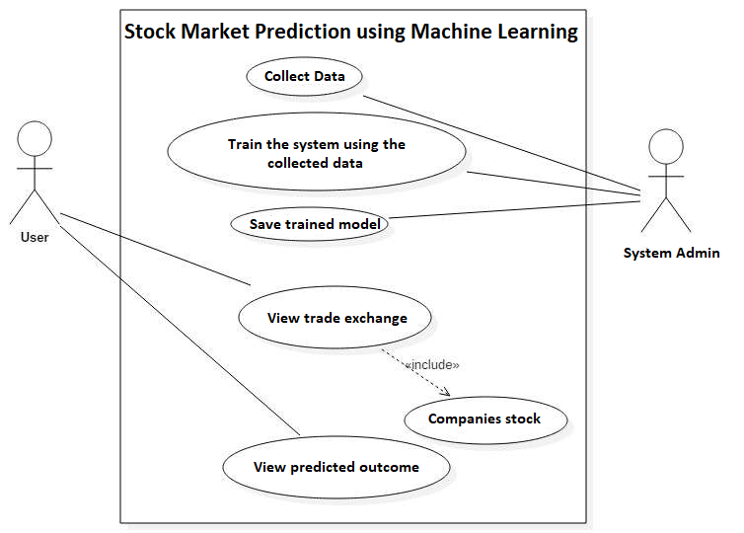
Stock Market Prediction
Architecture
System Design
USE CASE DIAGRAM
Data is initially collected from online sources or the stock exchange
The data is then used to train the system
Trained model is saved
User views the trade exchange and stock of a company
Using the model, closing prices are predicted

Slide 11
Stock Market Prediction
Architecture
Data Flow Diagram
Input : Company
Fetch Data
Plot Data
Train model (LSSVR)
Predict Stock for n Days
Plot Predicted Results
Save Model

Slide 12
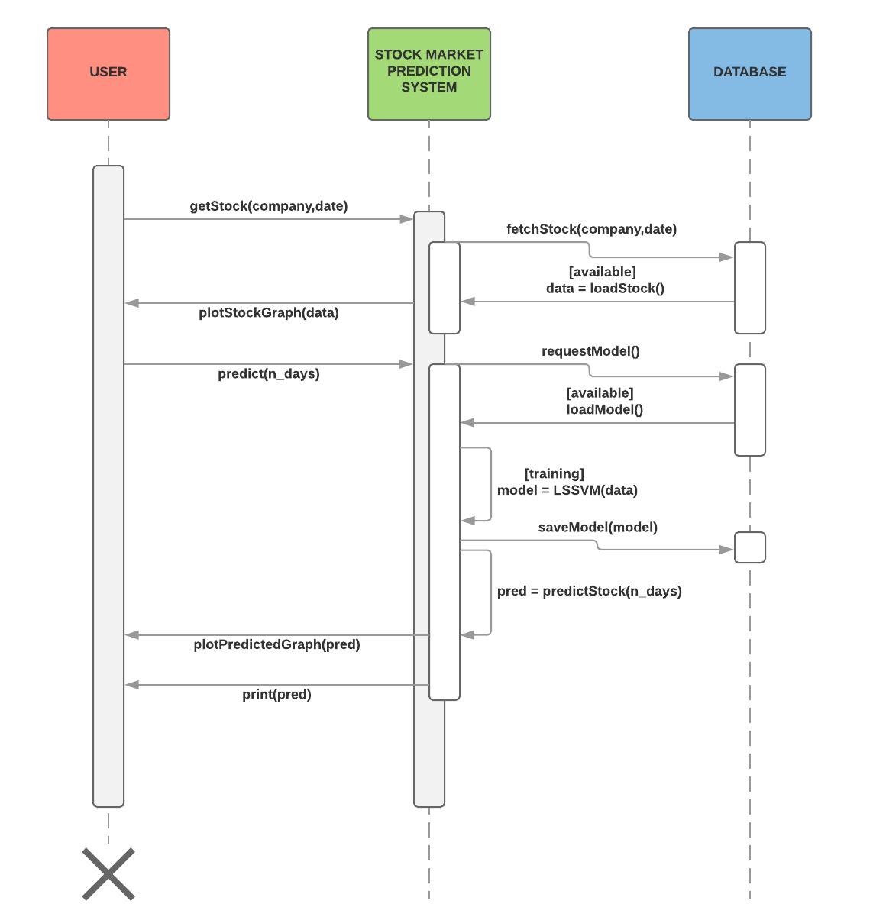
Stock Market Prediction
Architecture
Sequence Diagram
SEQUENCE DIAGRAM
User visits the website/webapp
Previously saved model is loaded
User requests for a company's stock data
He requests for prediction to be made
The Stock Market Prediction System trains a model using the data from the database
The model is saved for further use and closing price is predicted
Result is displayed along with graph

Slide 13
Stock Market Prediction
Implementation
Algorithm
Algorithm : StockPrediction
Input : COMP, D_RANGE, N_PRED [company, date range, n-day predictions]
Output : A vector of predicted prices and graph, RESULTS
data ← fetch stock for COMP in date range D_RANGE
plot(data)
train_data ← slidingWindow(data) //perform sliding window operation on data
RESULTS ← 0 //set accuracy vector to zeroes
for each day in N_PRED :
model ← LSSVM(train_data) //pass the training data to LSSVM
pred ← predict(model,day) //predict the price given model and day
remove first item from train_data //removing last item and adding predicted value
train_data ← add pred to train_data //Last In, First Out.
RESULTS ← add pred to RESULTS
end for
print(RESULTS)
plot(RESULTS)
return

Slide 14
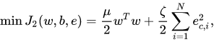
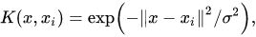
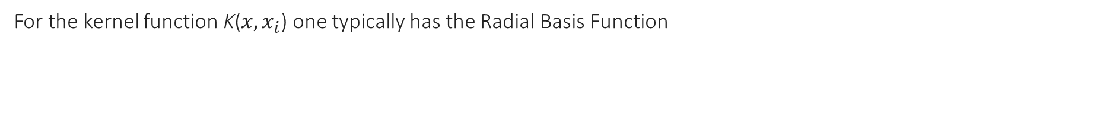
Stock Market Prediction
Implementation
LSSVR Formulation
Least Squares Support Vector Regression
The least squares version of the SVM classifier is obtained by reformulating the minimization problem as
For the kernel function K($x,x_{i}$) one typically has the Radial Basis Function
The LSSVR algorithm is a further development of SVR by Suykens (2001) and involves equality instead of inequality constraints, and works with a least squares objective function.
The LSSVR approach considerably reduces computational complexity and increases efficiency compared to standard SVM.
LSSVR solves linear equations instead of a quadratic programming problem

Slide 15
Stock Market Prediction
Implementation
Sliding-Window
Algorithm : slidingWindow
Input : data [stock data]
Output : A data frame of a lagged stock data
LAG ← 1
y ← remove first LAG rows from data
reset row indices of y
x ← remove last LAG rows from data
train ← merge (x,y) into a dataframe
rename column name to x and y
return train
Using previous time steps as input variables and use the next
time step as the output variable, we obtain the following table on the left
Re-organizing the time series dataset this way, we obtain the table as above, on the right

Slide 16
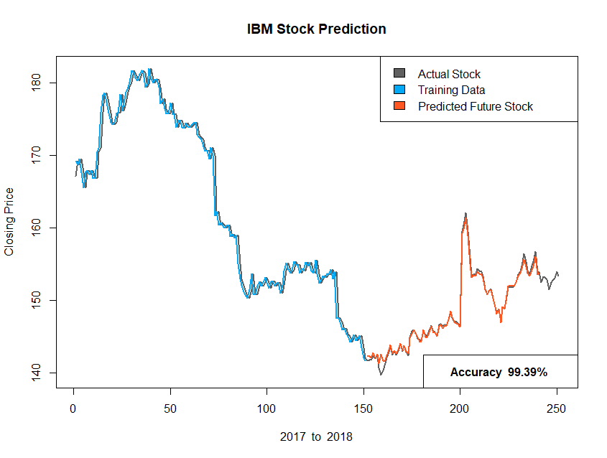
Results & Discussions
Stock Market Prediction

Slide 17
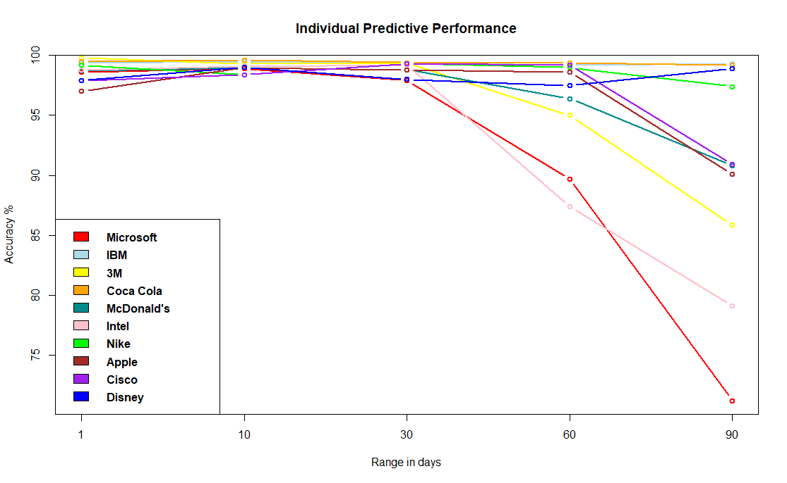
Performance
Stock Market Prediction

Slide 18
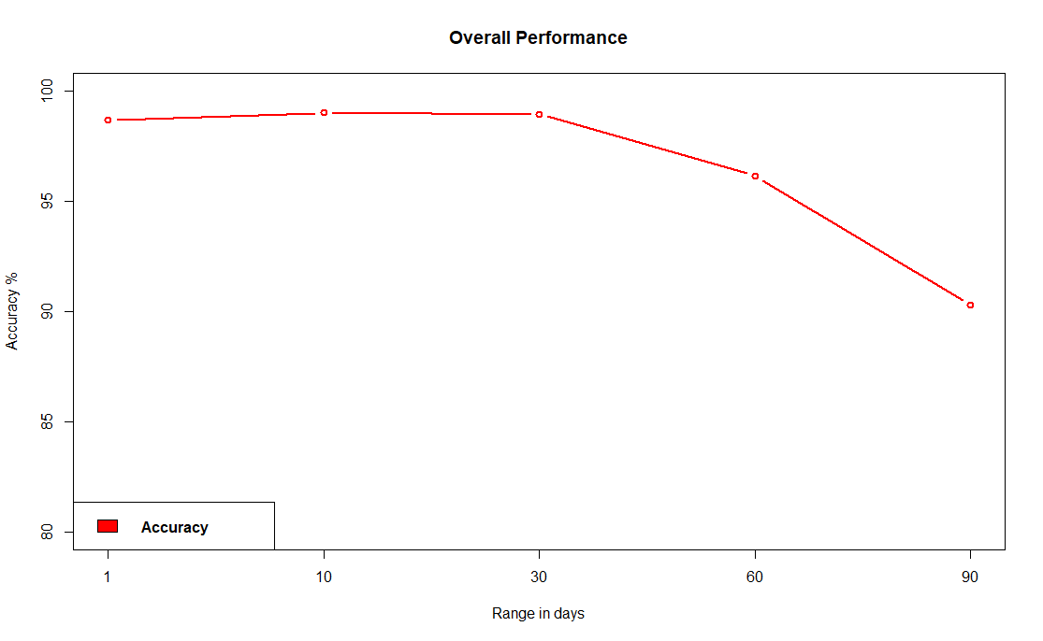
Performance
Stock Market Prediction

Slide 19
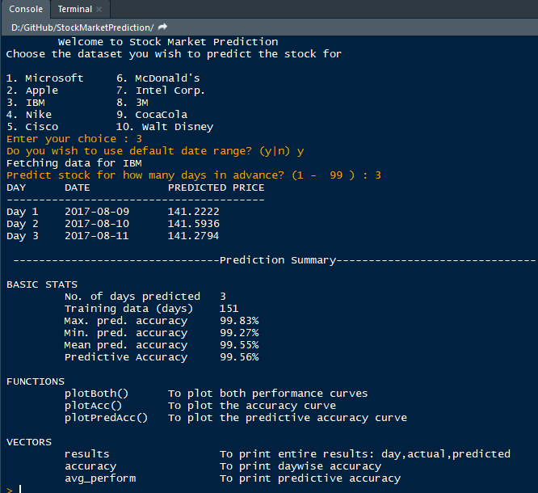
Stock Market Prediction
Screenshot

Slide 20

Stock Market Prediction
Future Enhancement
The limitation of the proposed system is its computational speed, especially with respect to sliding-window validation as the computational cost increases with the number of forward day predictions.
The proposed model does not predict well for sudden changes in the trend of stock data.
This occurs due to external factors and real-world changes affecting the stock market.
We can overcome this by implementing Sentiment Analysis and Neural Networks to enhance the proposed model.
We can modify the same system to an online-learning system that adapts in real-time.

Slide 21
Stock Market Prediction
Conclusion
Thus, as we can see above in our proposed method, we train the data using existing stock dataset that is available. We use this data to predict and forecast the stock price of n-days into the future.
The average performance of the model decreases with increase in number of days, due to unpredictable changes in trend.
The current system can update its training set as each day passes so as to detect newer trends and behave like an online-learning system that predicts stock in real-time.

Slide 22
Stock Market Prediction
Thank You

